Slide 1
Analysis of big mart sales
starry sky
20191003063 Vicky
20191003113 Erica
20191003208 Seven
20191002869 Lawrence
20191003140 Steve
20191002895 Lotty
20191003115 Chanera
20191003023 Russell

Slide 2
1.Data Information
2.Data Preprocessing
catalogue
3.Pig in Data Processing
4.Hive
5.Conclusion

Slide 3

一、Data Information
1.1 Dataset Introduction
1.2 Attribute Information

Slide 4



1.1 Dataset Introduction
The data scientists at BigMart have collected 2013 sales data for 1559 products across 10 stores in different cities. Also, certain attributes of each product and store have been defined. The aim is to build a predictive model and predict the sales of each product at a particular outlet.
Therefore, we hope to get some useful information from the data.

Slide 5
1.2 Attribute Information
Attribute | Meaning | Datatype
Item_Identifier | Unique product ID | string
Item_Weight | Weight of product | float
Item_Fat_Content | Whether the product is low fat or not | string
Item_Visibility | The % of total display area of all products in a store allocated to the particular product | float
Item_Type | The category to which the product belongs | string
Item_MRP | Maximum (list price) of the product | float
Outlet_Identifier | Unique store ID | string
Outlet_Establishment_Year | The year in which store was established | int
Outlet_Location_Type | The type of city in which the store is located | string
Outlet_Type | Whether the outlet is just a grocery store or some sort of supermarket | string
Item_Outlet_Sales | Sales of the product in the particular store. This is the outcome variable to be predicted. | float

Slide 6
二、Data Preprocessing
2.1 Missing values
2.2 Outlier

Slide 7
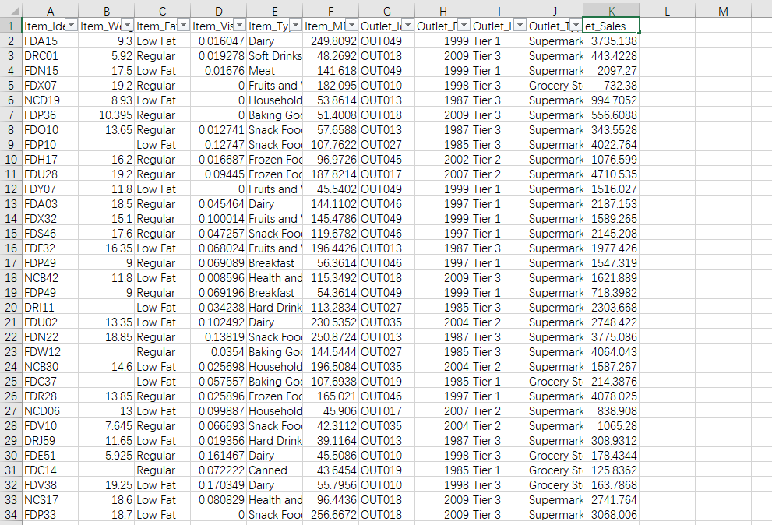
RAW DATA

Slide 8
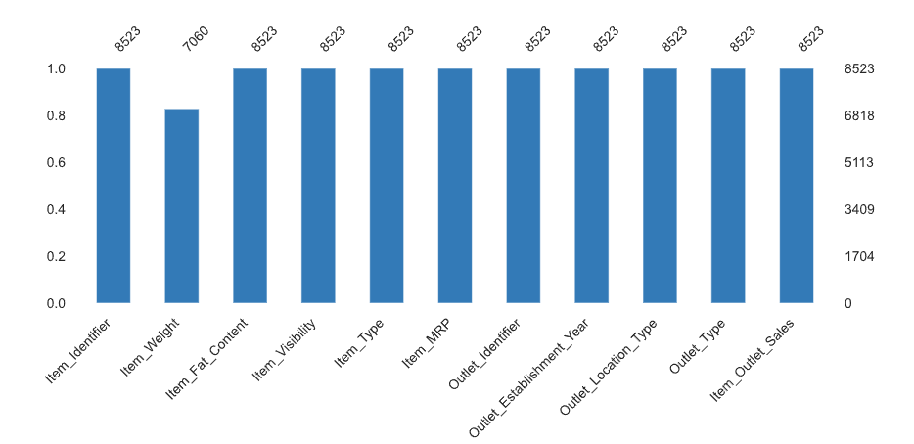
RAW DATA - Missing values
We can see just column “Item_Weight” has some missing value, then we don’t need to build a model in this report, and the data is very useful to us, so we decide to retain this data.

Slide 9
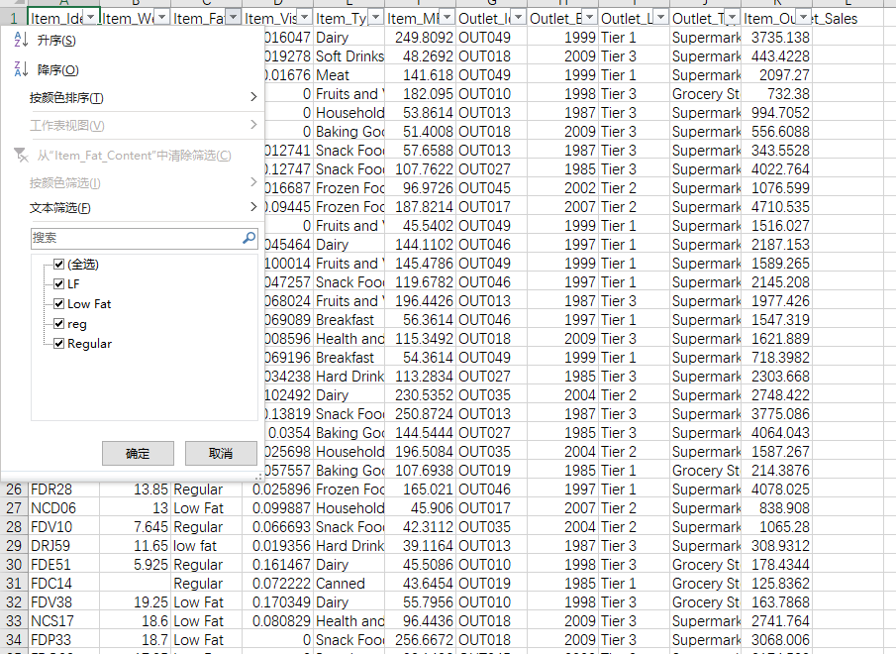

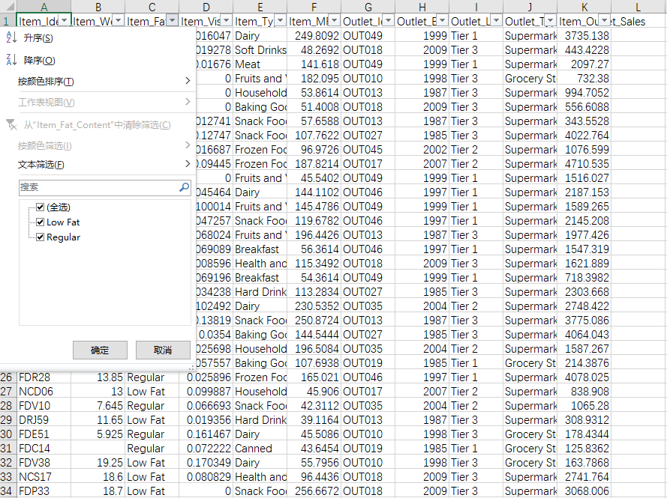
RAW DATA - Outlier
Here are codes:
import pandas as pd
df = pd.read_csv("ccm.csv")
df.replace('LF', 'Low Fat', inplace=True)
df.replace('reg', 'Regular', inplace=True)
df.replace('low fat', 'Low Fat', inplace=True)
df.to_csv('ccm.csv', index=False)

Slide 10
三、Pig in Data Processing
3.1 Data import using Hadoop
3.2 Using pig

Slide 11
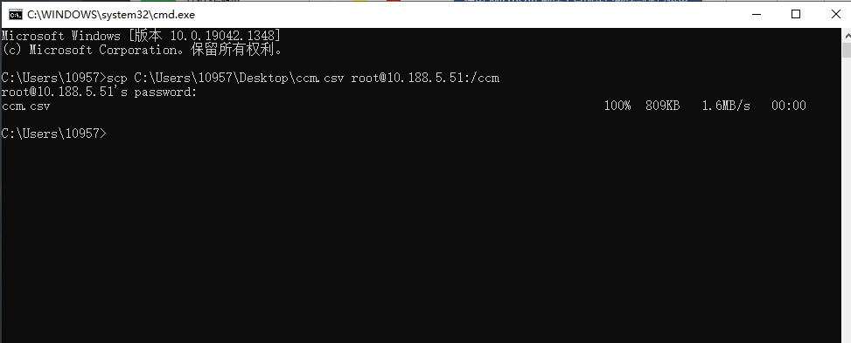
3.1 Data import using Hadoop
Use command ‘scp’ to put the csv file in the root package.

Slide 12
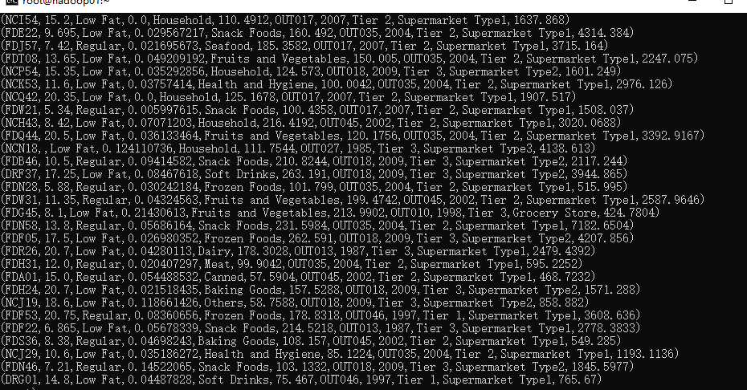
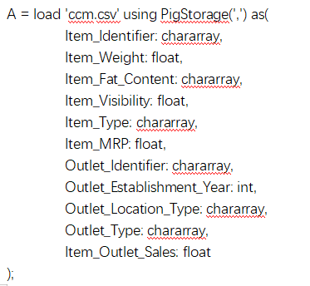
3.2 Using pig
(1) Import the csv file into pig.

Slide 13
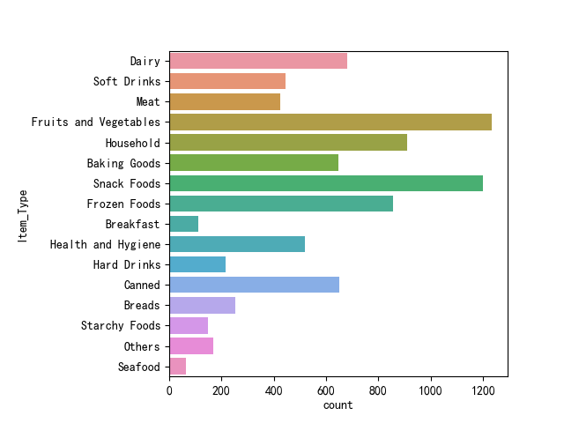
3.2 Using pig
(2) show the structure of A.
(3) Data distribution
describe A;
B = group A by Item_Fat_Content;
C = foreach B generate group, COUNT(A);
import matplotlib.pyplot as plt
import seaborn as sns
import pandas as pd
df = pd.read_csv("ccm.csv")
sns.countplot(y=df["Item_Type "], data=df)
plt.show()

Slide 14
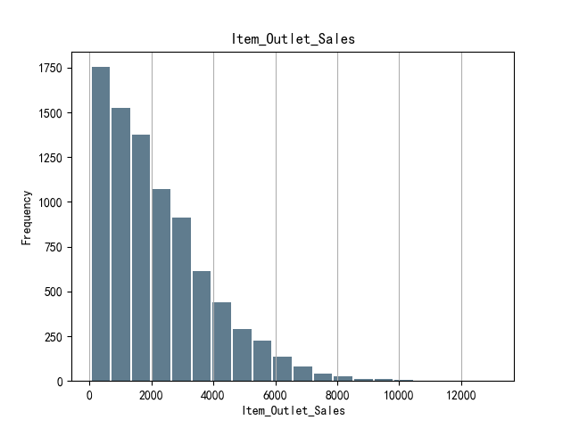
3.2 Using pig
(3) Data distribution
Here are the codes of python:
import matplotlib.pyplot as plt
import seaborn as sns
import pandas as pd
data = pd.read_csv("ccm.csv")
commutes = data['Item_Outlet_Sales']
commutes.plot.hist(grid=True, bins=20, rwidth=0.9, color='#607c8e')
plt.title('Item_Outlet_Sales')
plt.xlabel('Item_Outlet_Sales')
plt.ylabel('Frequency')
plt.grid(axis='y', alpha=0.75)
plt.show()

Slide 15
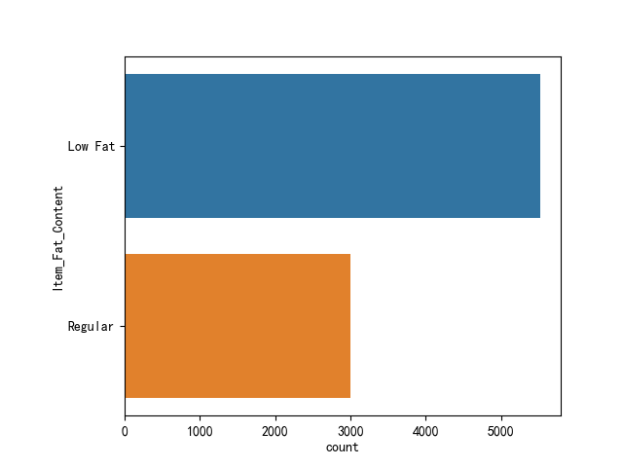
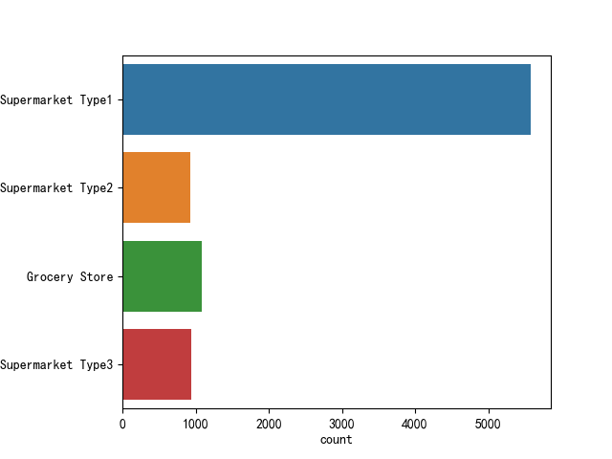
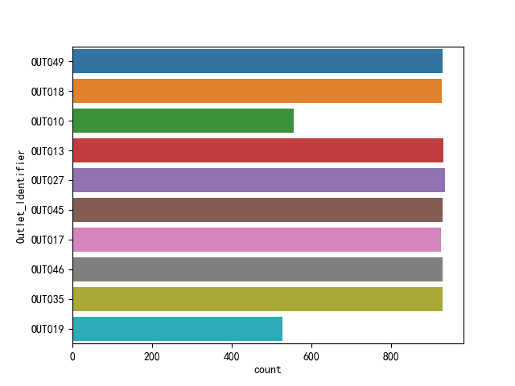
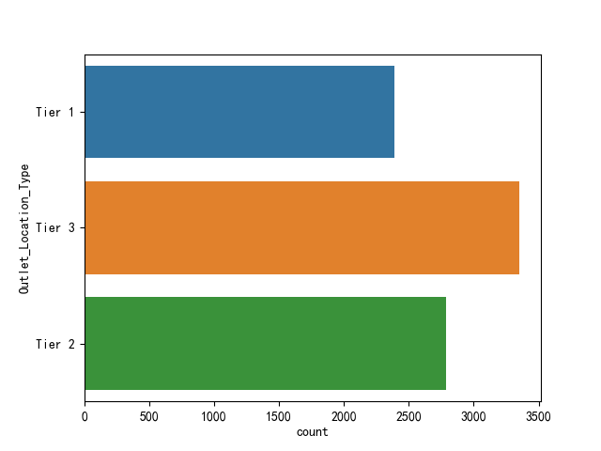
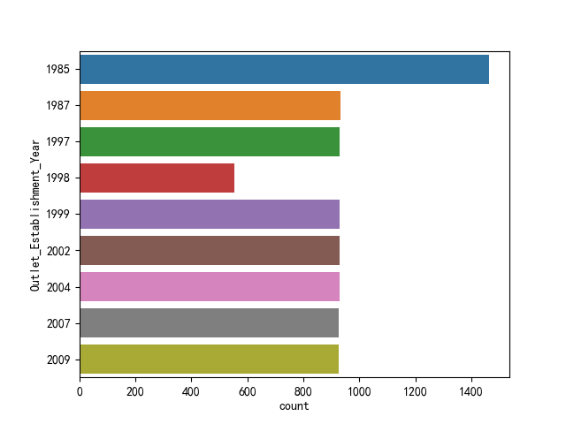
3.2 Using pig
Use the same way we can get the data distribution of each column. Here are other figures.

Slide 16
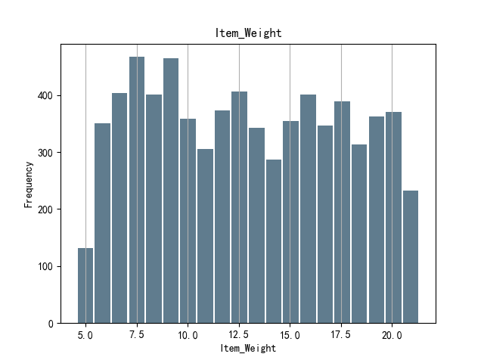
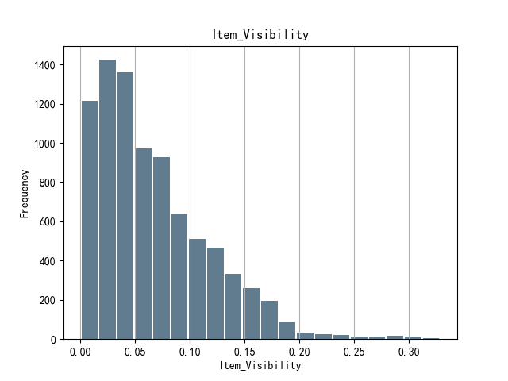
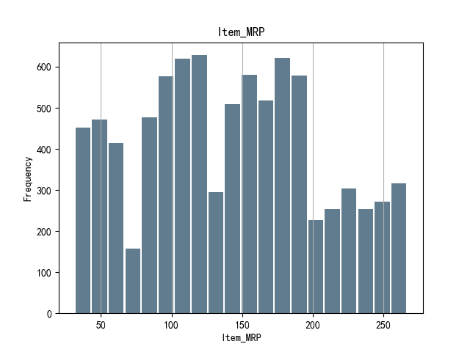
3.2 Using pig
Use the same way we can get the data distribution of each column. Here are other figures.

Slide 17
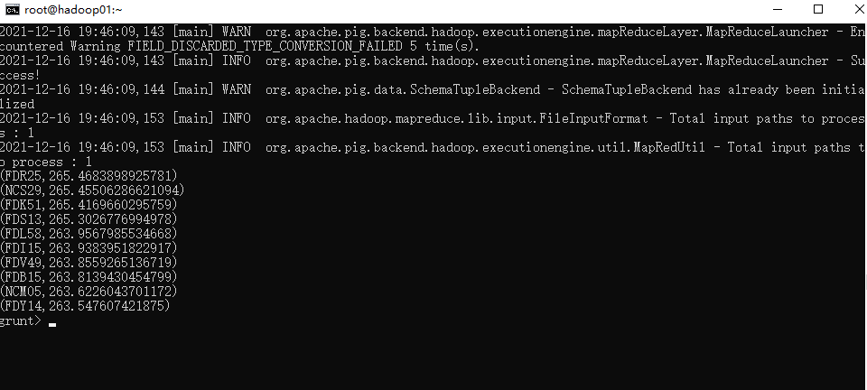
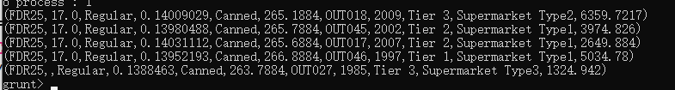
3.2 Using pig
(4) Retail Price Information
1. The average MPR of each item.
B = group A by Item_Identifier;
C = FOREACH B GENERATE group, AVG(A.Item_MRP);
D = order C by $1 DESC;
E = LIMIT D 10;
dump E
Select the most expensive item — ‘FDR25’.
B = FILTER A BY Item_Identifier == 'FDR25';
dump B
We can get information about the most expensive item. The most expensive item’s ID is FDR25. After filtering, we can know the item is Canned goods and it only sales in two types of supermarket.

Slide 18
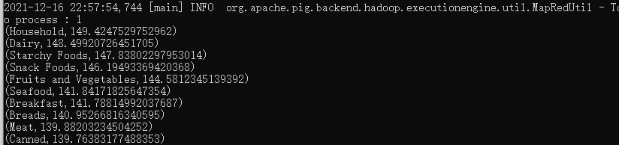
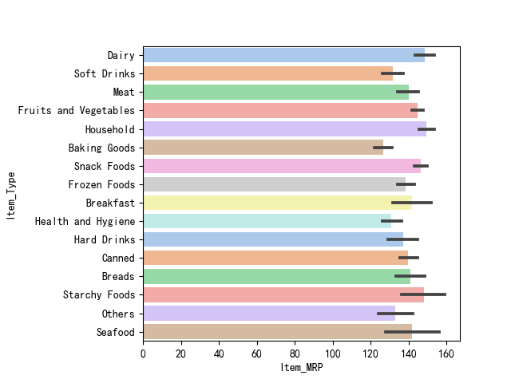
3.2 Using pig
(4) Retail Price Information
2. The average MPR of each Item_Type.
B = group A by Item_Type;
C = FOREACH B GENERATE group, AVG(A.Item_MRP);
D = order C by $1 DESC;
E = LIMIT D 10;
dump E
In this part, we can get information about which type of item is more expensive. The result of analysis shown us that household goods are the most expensive in all types of item.

Slide 19
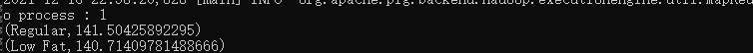
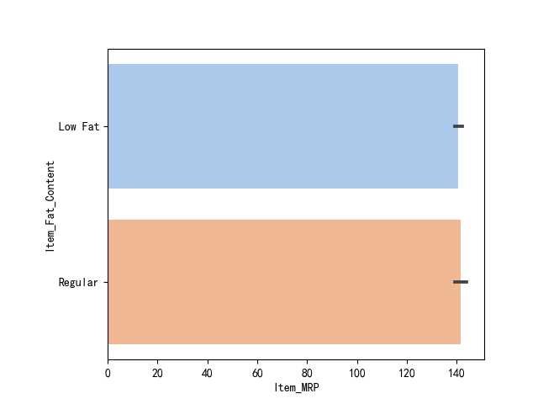
3.2 Using pig
(4) Retail Price Information
3. The average MPR of each Item_Fat_Content.
B = group A by Item_Fat_Content;
C = FOREACH B GENERATE group, AVG(A.Item_MRP);
D = order C by $1 DESC;
E = LIMIT D 10;
dump E
Item_Fat_content means whether the product is low fat or not, so we can know the MPR of regular product and the MPR of low fat product are similar.

Slide 20
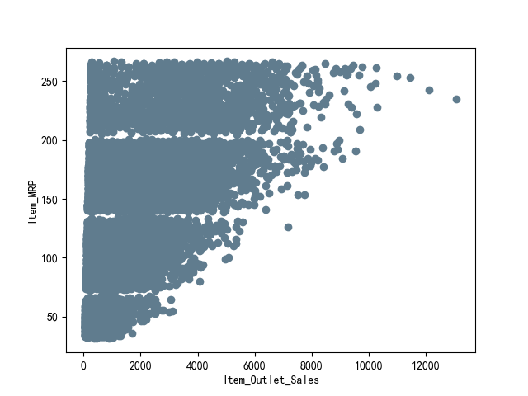
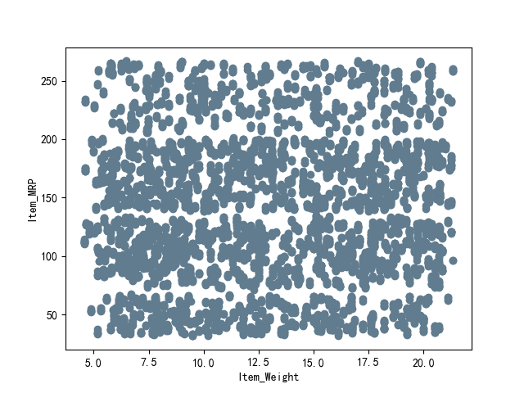
3.2 Using pig
(4) Retail Price Information
4. The relationship between MPR and other attributes
Here are the code:
df = pd.read_csv("ccm.csv")
plt.scatter(df["Item_Outlet_Sales"], df["Item_MRP"], color="#607c8e")
plt.xlabel("Item_Outlet_Sales")
plt.ylabel("Item_MRP")
plt.show()
plt.scatter(df["Item_Weight"], df["Item_MRP"], color="#607c8e")
plt.xlabel("Item_Weight")
plt.ylabel("Item_MRP")
plt.show()
plt.scatter(df["Item_Visibility"], df["Item_MRP"], color="#607c8e")
plt.xlabel("Item_Visibility")
plt.ylabel("Item_MRP")
plt.show()
Using the same way to analyze and use python to draw figures.
From the analysis results, we can know Item_Weight and Item_Visibility don’t have a strong relationship with MPR. Obviously, there is a positive correlation between Item_Outlet_Sales and MPR.

Slide 21
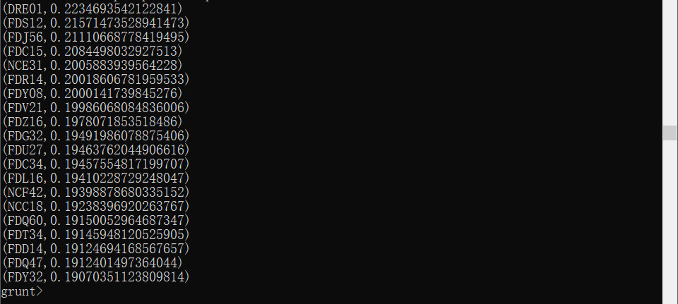
3.2 Using pig
(5) Visibility Information
1.The average visibility of each item.
B = group A by Item_Identifier;
C = foreach B generate group, AVG(A.Item_Visibility);
D = order C by $1 DESC;
E = LIMIT D 20;
DUMP E;
The 20 most popular goods
The 10 most popular goods (Table)

Slide 22
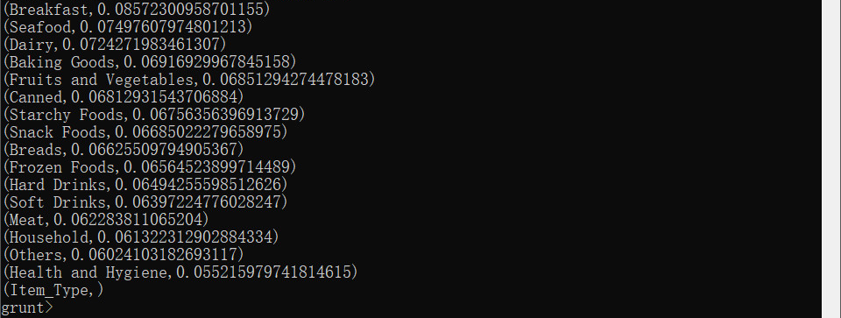
3.2 Using pig
(5) Visibility Information
2.The average visibility of each item.
B = group A by Item_Type;
C = foreach B generate group, AVG(A.Item_Visibility);
D = order C by $1 DESC;
DUMP D;
The popularity of item types (decreasing ordered)
The popularity of item types (Table)

Slide 23
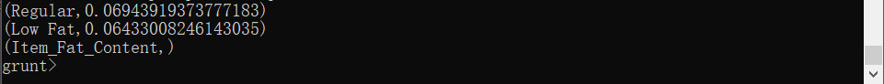
3.2 Using pig
(5) Visibility Information
3.The average visibility of each fat content.
B = group A by Item_Fat_Content;
C = foreach B generate group, AVG(A.Item_Visibility);
D = order C by $1 DESC;
DUMP D;
The popularity of item fat content (decreasing ordered)
The popularity of item fat content (Table)

Slide 24

3.2 Using pig
(6) Sales Information
1.The sales of each outlet type
grunt> t = group D by Outlet_Type;
grunt> at = foreach t generate group,AVG(D.Item_Outlet_Sales),SUM(D.Item_Outlet_Sales);
grunt> x = order at by $1 DESC;
grunt> dump x

Slide 25
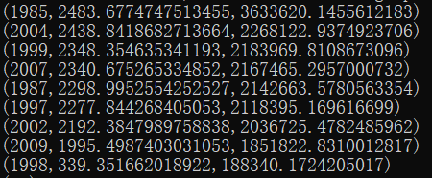
3.2 Using pig
(6) Sales Information
2.The sales of each year of establishment
grunt> esy = group D by Outlet_Establishment_Year;
grunt> aesy = foreach esy generate group, AVG(D.Item_Outlet_Sales), SUM(D.Item_Outlet_Sales);
grunt> x = order aesy by $1 DESC;
grunt> dump x

Slide 26
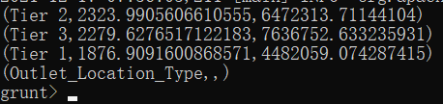
3.2 Using pig
(6) Sales Information
3.The sales of each location type
grunt> loc = group D by Outlet_Location_Type;
grunt> aloc = foreach loc generate group, AVG(D.Item_Outlet_Sales), SUM(D.Item_Outlet_Sales);
grunt> x = order aloc by $1 DESC;
grunt> dump x

Slide 27
四、Hive
4.1 Data loading
4.2 ETL & OLAP
4.3 Conclusion

Slide 28
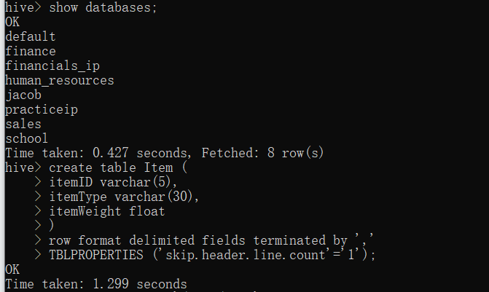
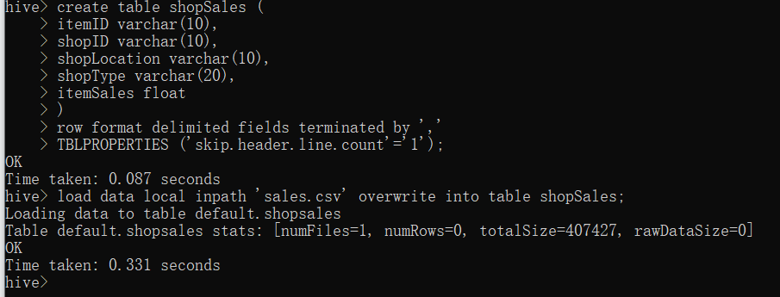
4.1 Data loading
Create database and table
1.Create database and table
create database big_mart_sale;
create table Item (
itemID varchar(5),
itemType varchar(30),
itemWeight float,
primary key (itemID)
)
row format delimited fields terminated by ','
TBLPROPERTIES ('skip.header.line.count'='1');
create table shopSales (
itemID varchar(10) primary key,
shopID varchar(10) primary key,
shopLocation varchar(10),
shopType varchar(20),
itemSales float
)
row format delimited fields terminated by ','
TBLPROPERTIES ('skip.header.line.count'='1');

Slide 29
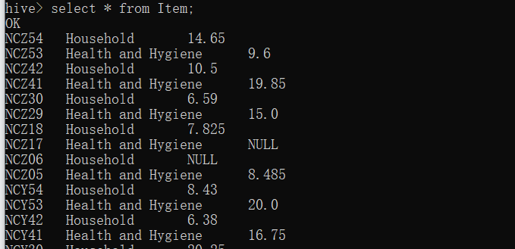
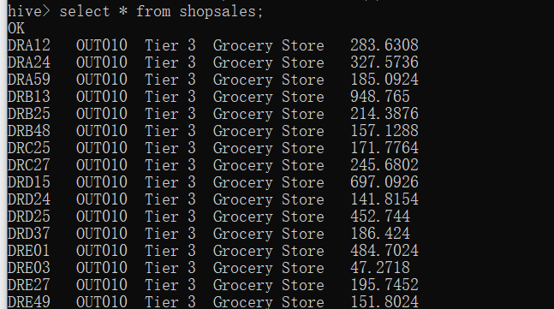
4.1 Data loading
Create database and table
2.Load from hdfs
load data local inpath 'item.csv' overwrite into table Item;
load data local inpath 'sales.csv' overwrite into table shopSales;
Then use command :
select * from item;
select * from shopsales;

Slide 30
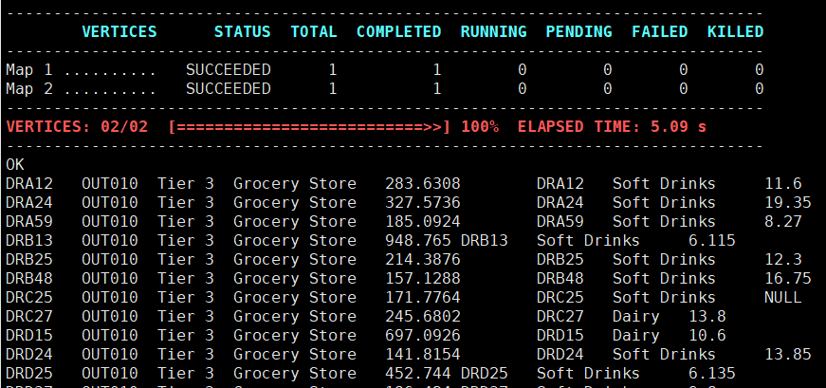
4.2 ETL & OLAP
(1) Join Tables
2.Load from hdfs
select * from shopSales S LEFT JOIN Item I
on S.itemID = I.itemID
limit 20;

Slide 31
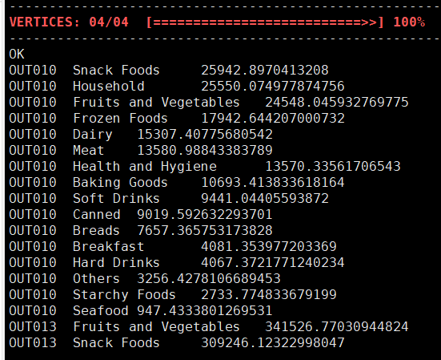
4.2 ETL & OLAP
(2) Use select
Use SUM() to get the total sales of each type of goods in each shop
select S.shopID, I.itemType, SUM(S.itemSales) as Totalsales
from shopSales S left join Item I
on S.itemID = I.itemID
group by S.shopID,I.itemType
order by S.shopID,totalsales desc;
The sales of snack foods in shop OUT010 is the highest.

Slide 32
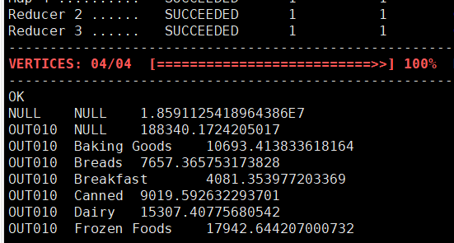
4.2 ETL & OLAP
(3) With Rollup
select S.shopID, I.itemType, SUM(S.itemSales) as Totalsales
from shopSales S LEFT JOIN Item I
on S.itemID = I.itemID
group by S.shopID,I.itemType with rollup
order by S.shopID,I.itemType;
from this command ,we can see the totalsales of each itemType each shop
There are the null value in the result.
This is the hierarchical aggregation with shopID dimension. And line2 mean the total sales of all categroy in shop OUT010. If we change the position of group by, such as ↓
Notes:
There are the null value in the result.
This is the hierarchical aggregation with shopID dimension. And line2 mean the total sales of all categroy in shop OUT010. If we change the position of group by, such as:

Slide 33
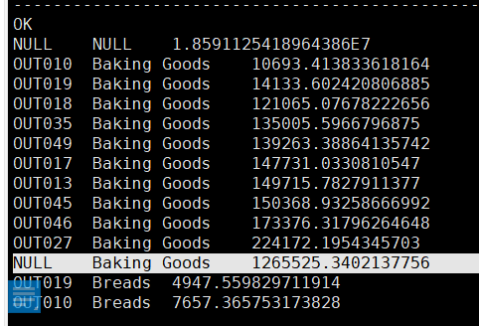
4.2 ETL & OLAP
(3) With Rollup
select S.shopID, I.itemType, SUM(S.itemSales) as Totolsales
from shopSales S LEFT JOIN Item I
on S.itemID = I.itemID
group by I.itemType,S.shopID with rollup
order by I.itemType,Totolsales;
This is the hierarchical aggregation with itemType dimension. And this line mean the total sales of baking goods in all the shop.
Notes:
There are the null value in the result.
This is the hierarchical aggregation with shopID dimension. And line2 mean the total sales of all categroy in shop OUT010. If we change the position of group by, such as:

Slide 34
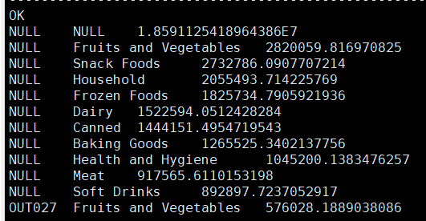
4.2 ETL & OLAP
(3) With Rollup
Order the data by the totalsales and get the result: we can see the Fruits and Vegetables are the best sell.
Notes:
There are the null value in the result.
This is the hierarchical aggregation with shopID dimension. And line2 mean the total sales of all categroy in shop OUT010. If we change the position of group by, such as:

Slide 35
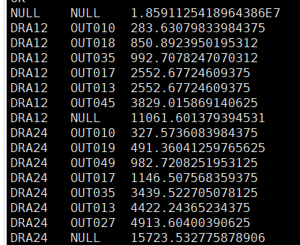
4.2 ETL & OLAP
(3) With Rollup
①the totalsales of each item each shop：
select I.itemID, S.shopID, SUM(S.itemSales) as Totolsales
from shopSales S LEFT JOIN Item I
on S.itemID = I.itemID
group by I.itemID,S.shopID with rollup
order by I.itemID,Totolsales;
Information:
The item ‘DRA12’ is best sell in shop ‘OUT045’ and the item ‘DRA24’ is best sell in shop ‘OUT027’.
Notes:
There are the null value in the result.
This is the hierarchical aggregation with shopID dimension. And line2 mean the total sales of all categroy in shop OUT010. If we change the position of group by, such as:

Slide 36
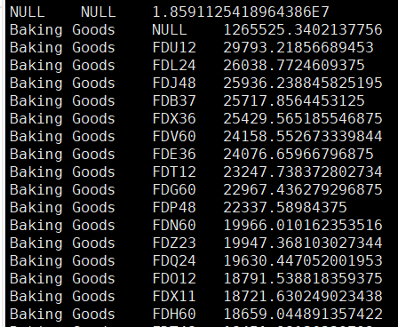
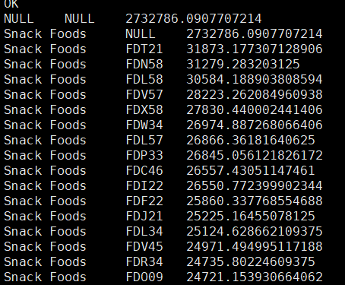
4.2 ETL & OLAP
(3) With Rollup
② the totalsales of each item each itemType：
select i.itemType,I.itemID, SUM(S.itemSales) as Totolsales
from shopSales S LEFT JOIN Item I
on S.itemID = I.itemID
group by I.itemType,I.itemID with rollup
order by I.itemType,Totolsales desc;
Information:
in all baking goods, the item ‘FDU12’ is best sell. And in all snack foods, the item ‘FDT21’ is best sell.
Use the where satement to get the detail that you want to know,such as “where shopID=?” or “where itemID =?”
Notes:
There are the null value in the result.
This is the hierarchical aggregation with shopID dimension. And line2 mean the total sales of all categroy in shop OUT010. If we change the position of group by, such as:

Slide 37
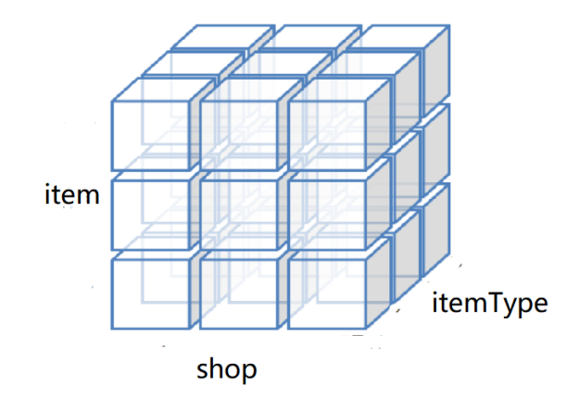
4.2 ETL & OLAP
(4) Cube
Cube can query multiple dimensions of hive. With cube, You don't have to write a lot of select statements and union them.
When building the data cube. For instance, dicing to face the data cube of shopID, itemType and itemID.
Notes:
There are the null value in the result.
This is the hierarchical aggregation with shopID dimension. And line2 mean the total sales of all categroy in shop OUT010. If we change the position of group by, such as:

Slide 38
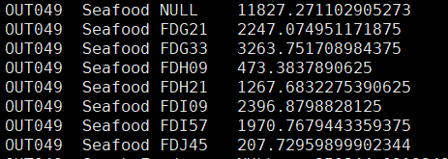
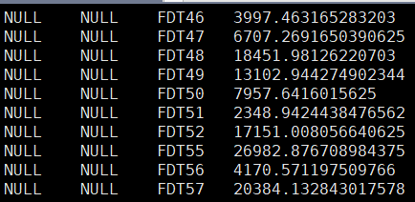
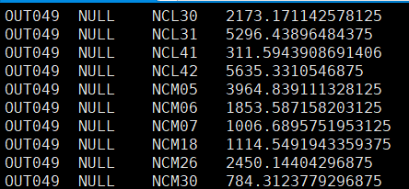
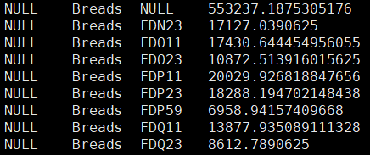
4.2 ETL & OLAP
(4) Cube
select S.shopID,I.itemType,I.itemID, SUM(S.itemSales) as Totolsales
from shopSales S LEFT JOIN Item I on S.itemID = I.itemID
group by S.shopID,I.itemType,I.itemID with cube;
Notes:
There are the null value in the result.
This is the hierarchical aggregation with shopID dimension. And line2 mean the total sales of all categroy in shop OUT010. If we change the position of group by, such as:

Slide 39
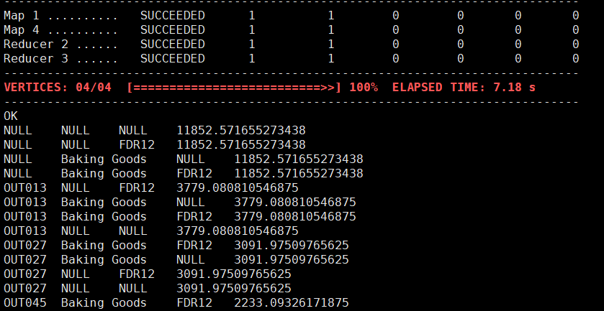
4.2 ETL & OLAP
(4) Cube
It only focuses on some dimensions,For instance: shopID = “FDR12”,
select * from
(select S.shopID,I.itemType,I.itemID, SUM(S.itemSales) as Totalsales
from shopSales S LEFT JOIN Item I on S.itemID = I.itemID
group by S.shopID,I.itemType,I.itemID with cube) a
where a.itemID ='FDR12'
order by a.Totalsales desc;
Notes:
There are the null value in the result.
This is the hierarchical aggregation with shopID dimension. And line2 mean the total sales of all categroy in shop OUT010. If we change the position of group by, such as:

Slide 40
4.2 ETL & OLAP
·apply UNION command together with ROLLUP command for cube view
select S.shopID,I.itemType,I.itemID, SUM(S.itemSales) as Totolsales
from shopSales S LEFT JOIN Item I
on S.itemID = I.itemID
group by S.shopID,I.itemType,I.itemID with rollup;
UNION
select Null,I.itemType,I.itemID, SUM(S.itemSales) as Totolsales
from shopSales S LEFT JOIN Item I
on S.itemID = I.itemID
group by I.itemType,I.itemID with rollup;
UNION
select S.shopID,Null,I.itemID, SUM(S.itemSales) as Totolsales
from shopSales S LEFT JOIN Item I
on S.itemID = I.itemID
group by S.shopID,I.itemID with rollup;
Notes:
There are the null value in the result.
This is the hierarchical aggregation with shopID dimension. And line2 mean the total sales of all categroy in shop OUT010. If we change the position of group by, such as:

Slide 41
Conclusion
According to query, we can know：
which kind of goods in the same type sell better
the best-selling goods in different stores
and so on.
So we can do：
selectively increase the amount of hot items in the store
select the best-sell good of the same type when purchasing
....
Notes:
There are the null value in the result.
This is the hierarchical aggregation with shopID dimension. And line2 mean the total sales of all categroy in shop OUT010. If we change the position of group by, such as:

Slide 42
Thanks for watching
Starry sky

